Slide 1

Enabling Great Teams
Alex Alexandrov
Jim Kimball - @jimkimball

Slide 2
Where do you start?
Notes:
Alex: Someone made you a leader. I hope you know why.
But here we are talking about real leaders, not someone with a title in an org chart.
So before we even start talking about being a leader I feel that you must already love what you do.
Because it’s going to be very hard work.
---------------------
In my case that’s CODING. And what I really mean by coding is solving problems and delivering value by writing well-written, well-tested code! So I love that.
2) The second but equally important is that I work really hard. And continuously working hard is very exhausting, and sometimes takes a toll on my personal life.
When you love what you do and you consistently work hard, you become the go-to-person and that establishes you as a leader on your team without any additional need for titles or ceremony.
That said, just loving what you do and working hard is not enough!

Slide 3
public class LearnJava { public static void main(String[] args) { System.out.println(“Hello, world”); } }
Notes:
Alex: For Software Engineers a common place to start is to write, compile and run the basic “Hello, world!” program, like the one shown here and then you can add some extra code between the lines and you’re on your way... Usually in any new technology you can find a comprehensive manuals and books.
However, to engineer a great working team, there is no quick way to compile a working program.
Unfortunately there is NO Hello, World for enabling great teams.

Slide 4

Notes:
Jim - XP explained gave me a launching off point. Our goal today is to give that to you.
We are going to discuss 4 areas where you and your teams can improve that you can apply today
Alex: Extreme Programming was also a starting point for me. Extreme Programming was the Agile methodology that HedgeServ was using when I went in for my interview about 10 years ago, and I was blown away by the interview process where I got to pair program with some great people I wrote tests and the corresponding code for it and after 10 hours I left feeling great.
Jim: I’m going to introduce some theory that has helped me over the years...
Alex: And I’ll talk about my practical experiences growing a team here in Sofia
Jim: In this talk, we will identify four key areas that have been important for us as we’ve worked with teams, and hopefully they can help you too

Slide 5
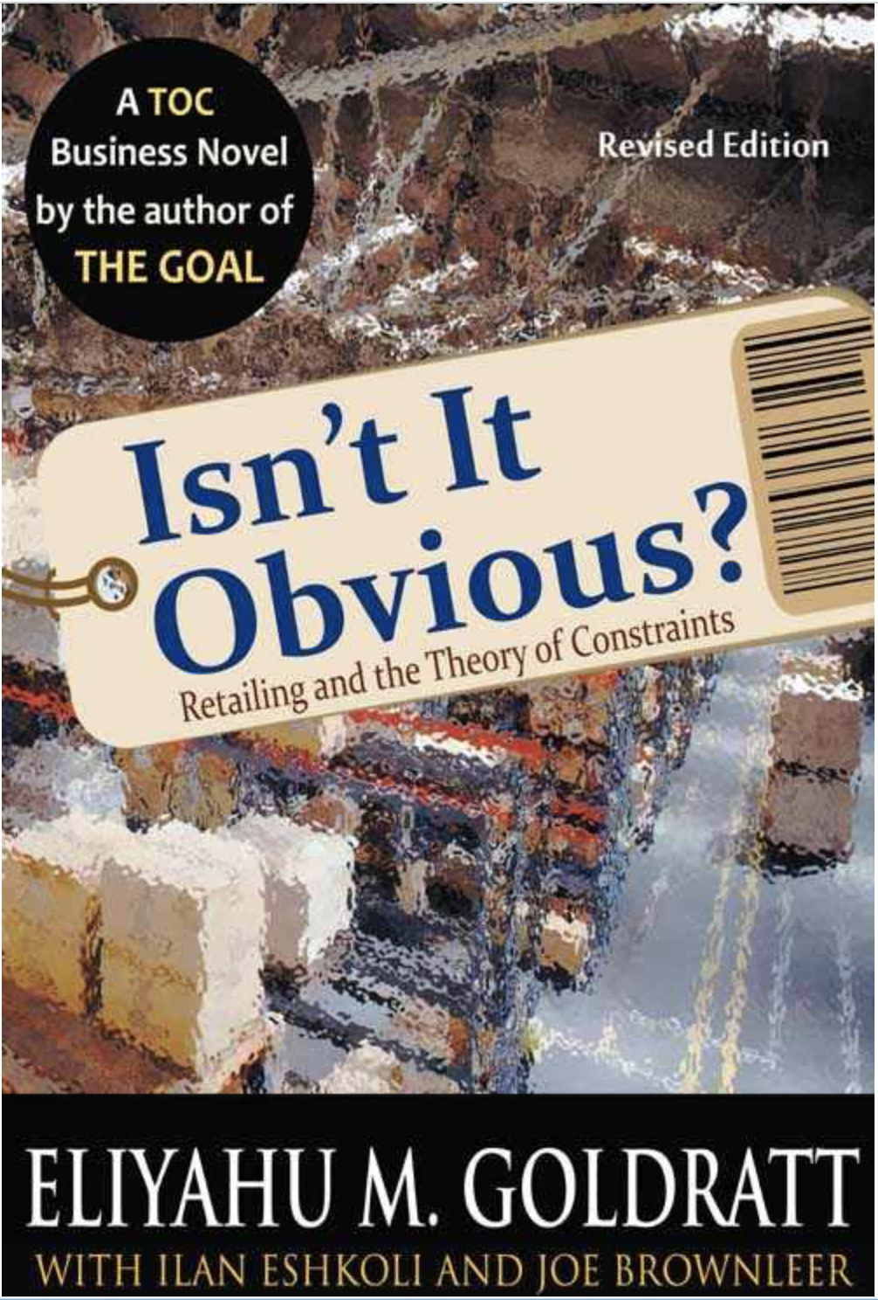
https://books.google.co.uk/books/about/Isn_t_it_Obvious.html?id=srNpQgAACAAJ&source=kp_cover&redir_esc=y
Notes:
Jim - obvious

Slide 6

Communication
https://www.yourerc.com/blog/post/are-supervisors-allowed-to-yell.aspx
Notes:
Jim – it’s always a people problem, it’s always a communication problem

Slide 7
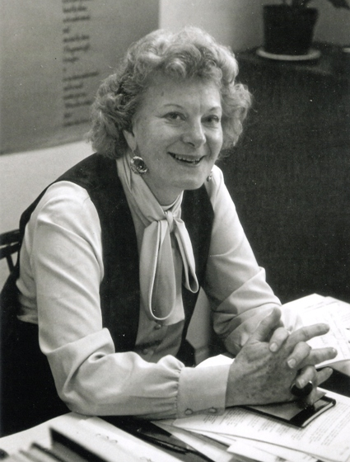
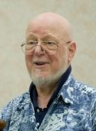
Satir Interaction Model
http://www.shiuhli.org.tw/images/satir/virginia_satir.jpg
https://www.smashwords.com/profile/view/JerryWeinberg

Slide 8
Satir Interaction Model
Intake
Meaning
Significance
Response
Focus
What I heard was …
What did you see or hear?
Emotion
Rules
Congruence
Notes:
J – discuss; rule – “I have to know everything”
Alex – The theory is nice, but how do I apply it in practice?
When it comes to the INTAKE process on my team we say the best form of communication is talking, two or more people talking face to face.
Some of the best engineers that I’ve worked with are by nature introverts and they prefer to kind of hide behind the comfort of a computer screen.
Team members will spend enormous amount of time chatting, emailing and using all forms of communication even when they sit right next to each other?
I encourage you if really want to unleash your team’s talent to have people talk to each other. It gives everyone a better chance to understand their point, allows for emotions to be interpreted properly and most likely would resolve whatever issue you’re working on by the end of the conversation or would at least pave the road for the solution.
That said, always follow up with an email and, always CC the team. It creates an open environment where people feel comfortable discussing anything, and the success of resolving the issue is clearly communicated...
-----
Rules: We have rules around communication where we created an environment that it’s expected that everyone can teach everyone.

Slide 9
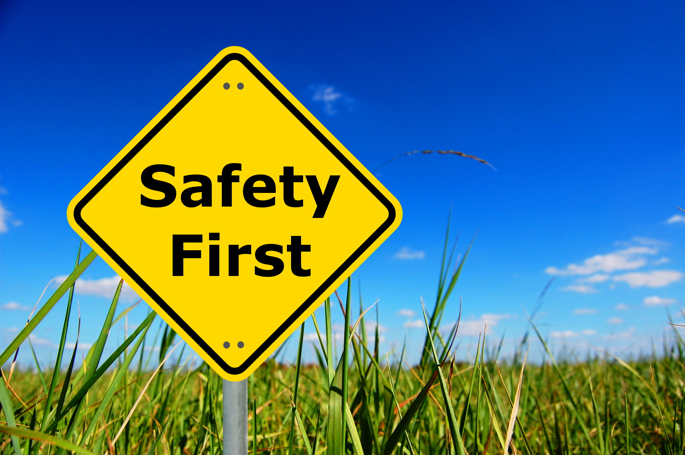
Communication
Safety
Notes:
Establish new rules for people to use that are all agreed upon in safety. Then practice those rules.
Talk about communication before you need it.
We hear a lot about safety. How do you get there?
Alex: Safety here follows up on our previous topic about communication. For face to face communication to be effective you need to feel safe to express yourself.
Chances are that you already have some really smart people on your team and if they don’t feel safe to communicate and express their ideas or solutions, some great opportunities will be missed.
And here comes the question of how do you establish that safe environment?

Slide 10
Values, Principles and Practices
Notes:
Jim: Introduce values and principles.
Alex:

Slide 11
Values
What is important to us?
Communication
Respect
Honesty
Courage
Teamwork
Notes:
Jim: As you can see the values are very generic. They have nothing to do with technology.
Alex: Here are some examples of the values my team came up with. I’ll talk a little about some to show how they impact our behavior.
Teamwork is very important to us. We do everything as a team (like support, like interviews, …). I even find myself more productive by just repeating my ideas to my pairing partner.
Another value I want to highlight is honesty. Jim talked about congruence in communication. Establishing honesty as a value has allowed my team to be brutally honest with each other and so people can say what they think and that is ok. As a result we cut through a lot of the crap to get stuff done.

Slide 12
Principles
What do we believe?
The best form of communication is people talking face to face
The only measure of progress is running software
The best way to deliver value is through frequent, small releases
Notes:
Jim: These are context specific – they should be decided by the team
Alex: I’ll do the same thing here as I did with Values. You can see one of my team’s principles is “the only measure...”
Having this principle helps us deal with the fact that every developer is always 90% done.
We really have two status: working on it, or done, and by done we mean running demonstrable software. Our whole team, including the product owner and business analysts understands this and it enables us to have very simple, straightforward conversations – “what is the status of this story?” “I am working on it.” “Got it.”

Slide 13
Practices
What are we going to do?
Small stories
Put the same effort into tests and test code as production code
Commit frequently
Refactor aggressively
Pair and Rotate Pairs
Run our code
No blaming
Notes:
Jim: These are context specific – they should be decided by the team
Alex: So pairing isn’t common, isn’t for everyone, but on my team we agreed to do it, cause we find it very productive. That allows us to put the new person who started yesterday to work on production issues day one, cause they’re pairing with someone who can help.
Refactoring is scary and product owners and project managers might tell teams not to do it.
The application my team works on it it has 10+ year of code history, so it’s much easier to just go in, make the change required and get out.
But we’ve agreed that we need to refactor aggressively in order to maintain quality code, so having this practice ensures that my team doesn’t do the easy thing it does the right thing
And these are not static. On my team practices are a result of something that works for us. For example we used to estimate stories by points and we eventually decided that that’s a waste of time, so we stopped and I’ll tell you later what we do today.

Slide 14
Discussion
Dialog
Understand
Get best solution
Listen
Ritual Dissent
Clarifying questions
Rule of Three
Notes:
J - slide
A - To establish practices, you need regular dialog and discussion
Alex: And they way we do this on my team is when a technical problem needs to be addressed, we get into a dialog to explain to the business owner and the QAs what’s involved and what’s at stake and even technical details about proposed solution.
And after everyone understands then we move onto discussing solution, side effects, expected testing complications and so on.
So what you get out of it is
-- the whole team hears about it
-- we come up with a better solution

Slide 15
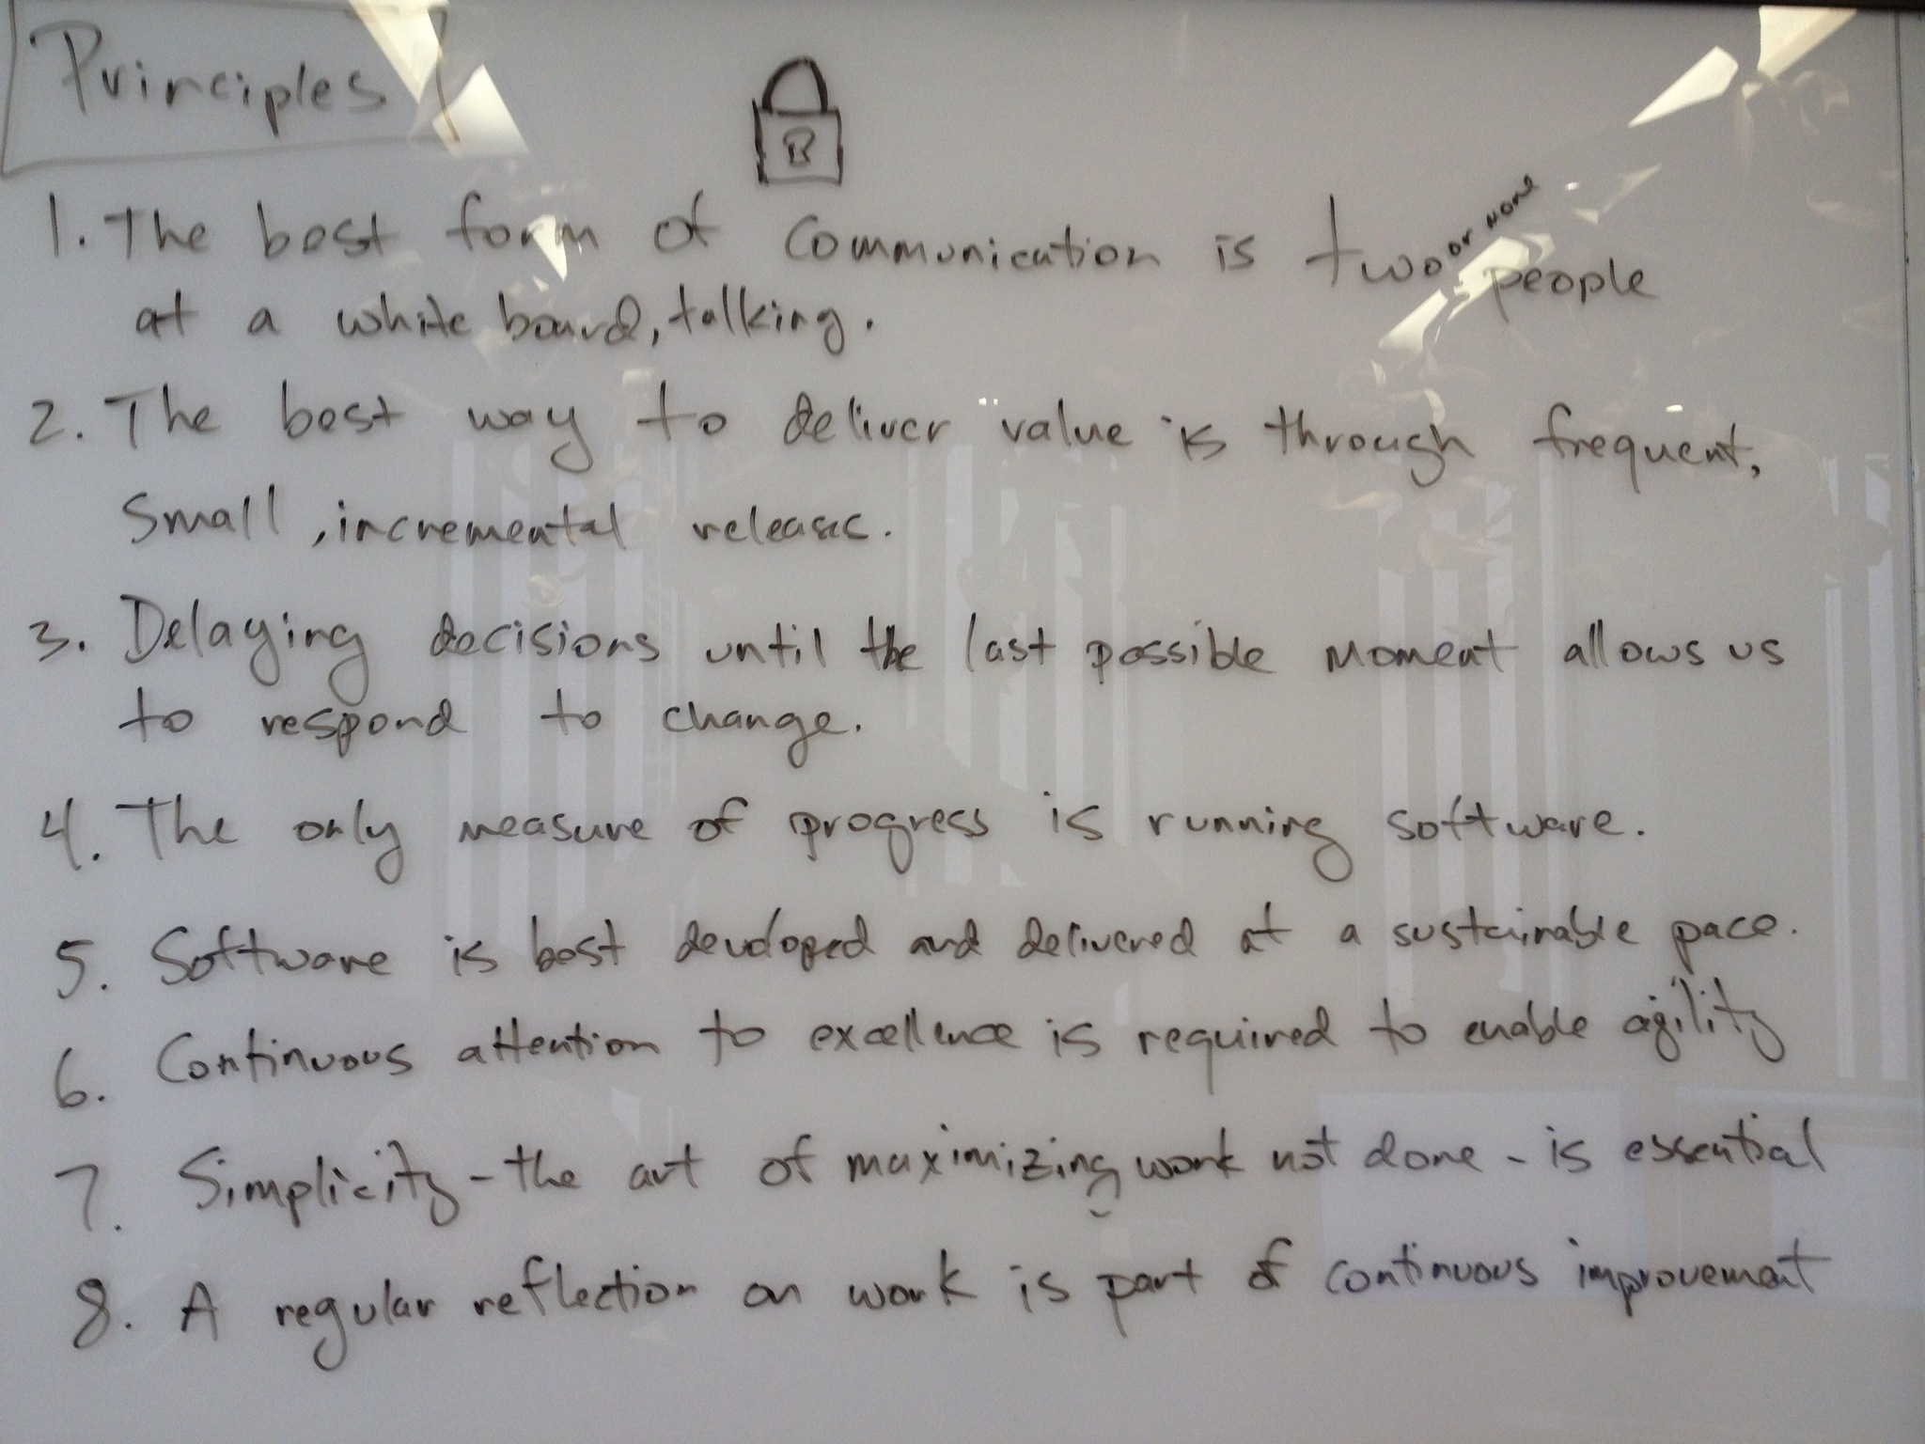
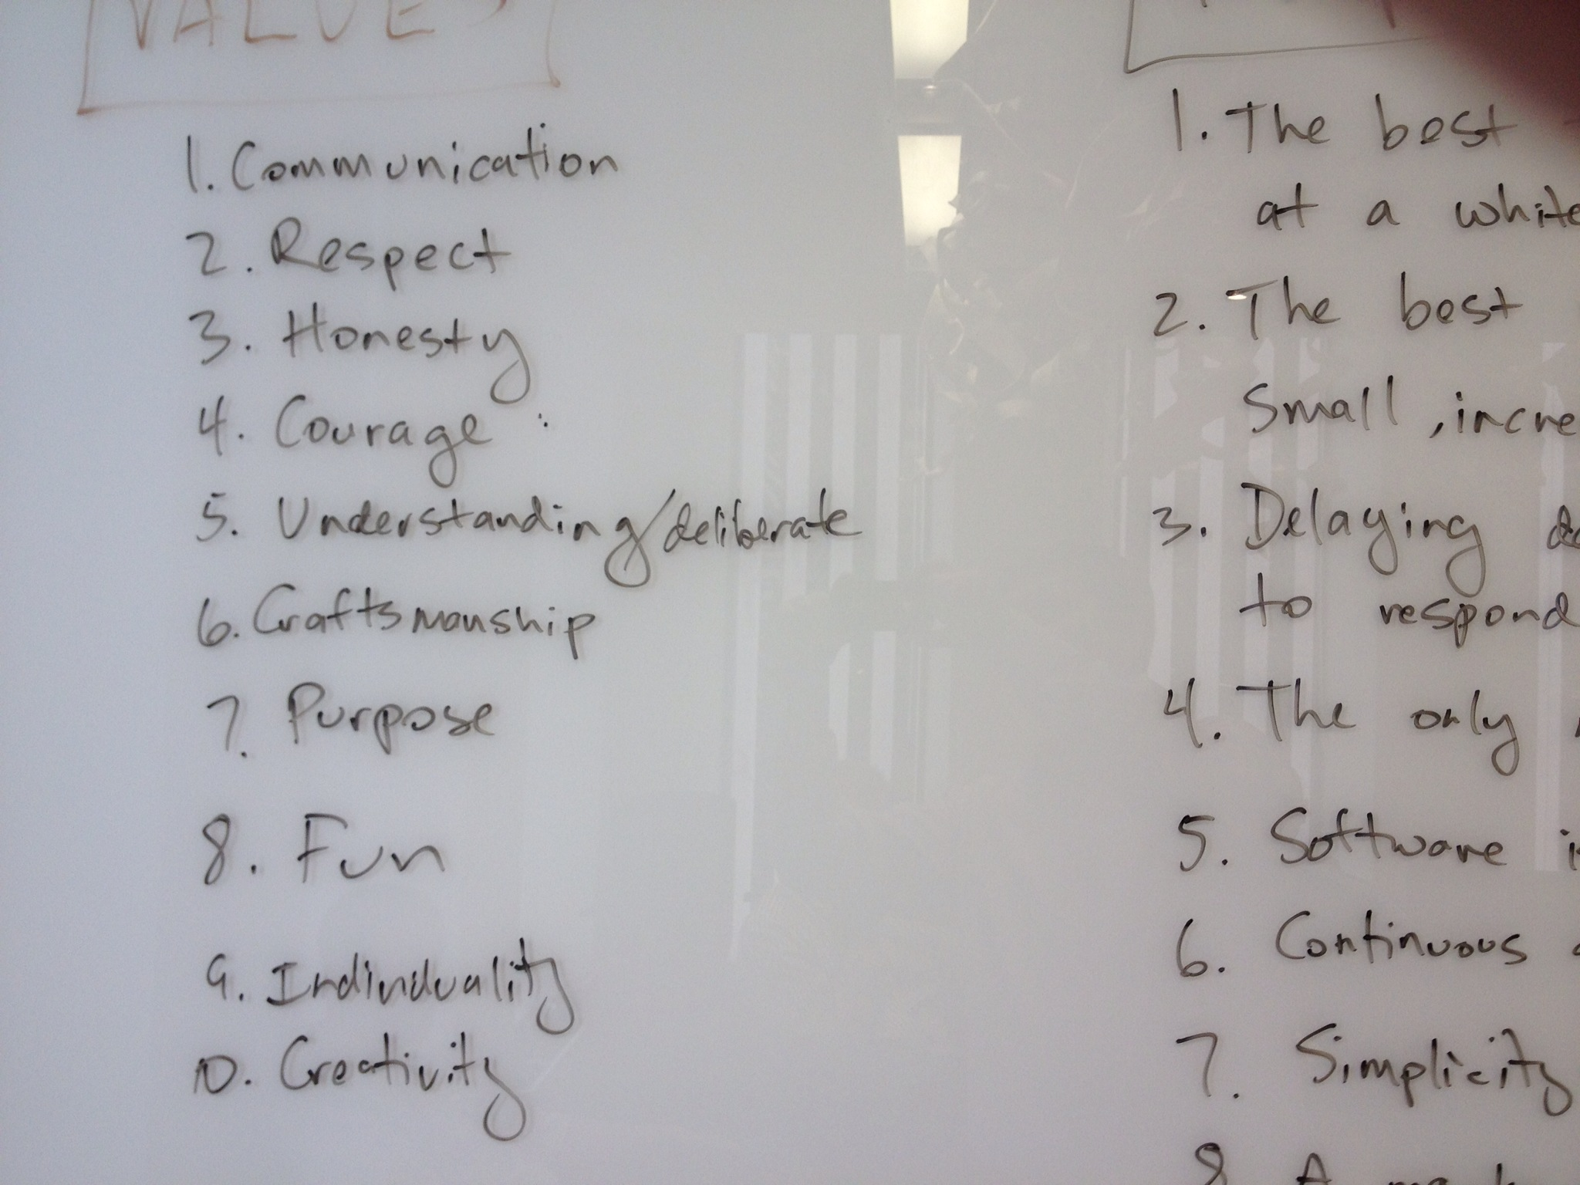
Notes:
Alex: What we did is sat down, or we actually stood up, and came up with ours on the white board and here they are.

Slide 16
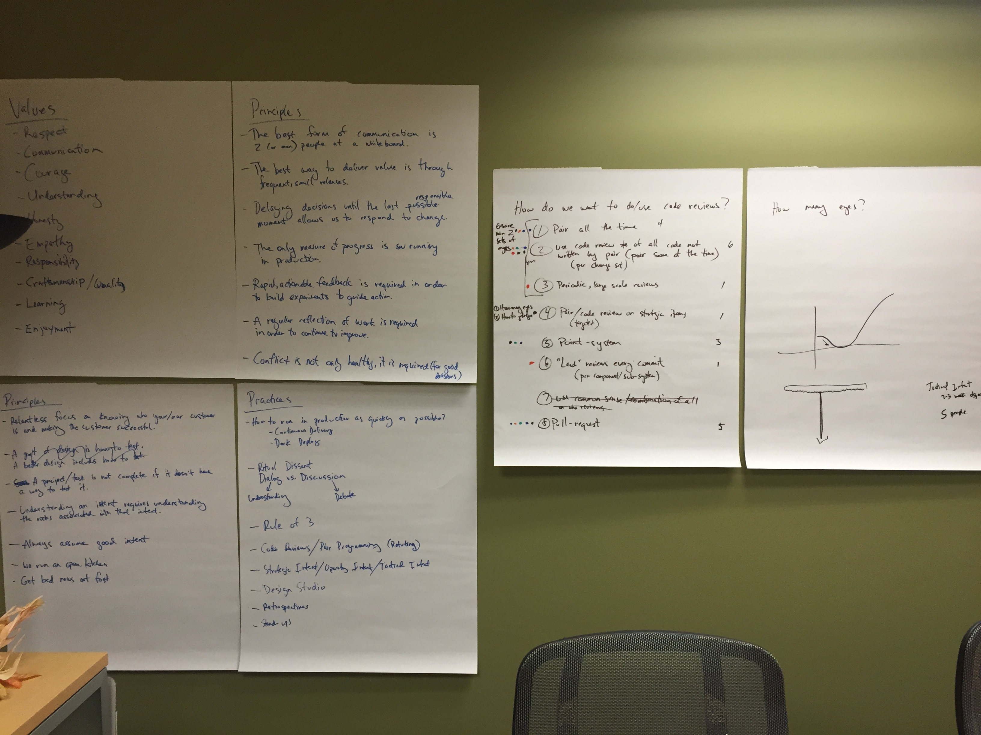
Notes:
Jim: don’t worry that you can’t read these. The important thing is that you and your team can come up with your own. And, when getting started, feel free to steal ours. We stole ours from Kent Beck and then adapted.

Slide 17
What do you want me to do?
Notes:
Bungay – “Answering that simple question, ‘What do you want me to do?’ is quite a problem”

Slide 18
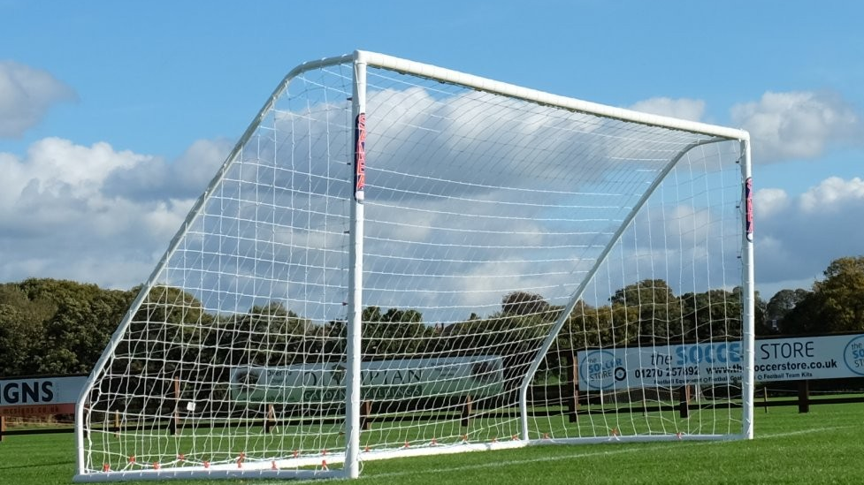
Communication
Safety
Goals
https://www.thesoccerstore.co.uk/samba-16-x-7-match-goal
Notes:
It is not about command and control
Ackoff – Systems thinking
Deming – There is no substitute for teamwork and good leaders of teams to bring consistency of effort, along with knowledge.
Deming – Quality comes not from inspection, but from improvement of the production process – Out of Crisis

Slide 19
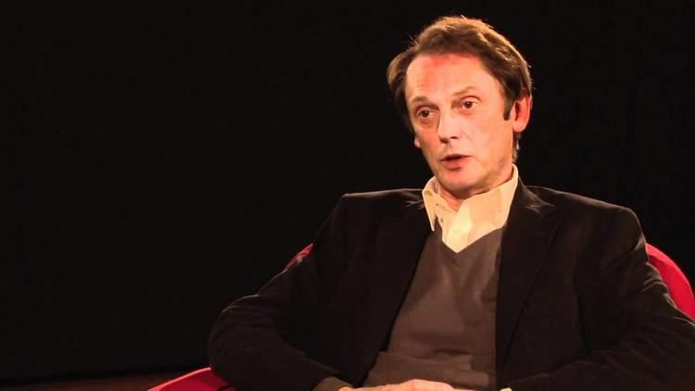
Mission
Intent
https://alchetron.com/Stephen-Bungay#-
Notes:
Conflict between two senior people in the team.

Slide 20
Multiple horizons
Tactical
Operational
Strategic
1 week
1 month
6 months
Notes:
Alex – this is the business. You need to do it. I stress this to our team.
BUT, I also ensure that we get time to work on our things. We run experiments. I spend time with people to understand (<- VALUE).
---
Alex: So on my team the business guys own the Operationl goals, and the development team owns the tactical goals.
Our priorities can change day to day.
On any given day someone on the team might finish a story and they don’t go to project planning tools, like Jira, they call the business guys, the product owner and we talk about what are the priorities and what’s defined so that we can work on that next.
Remember how I said that we don’t estimate story points any more, what we do is we just go by priorities daily.
In this way we constantly delivering the most value in our monthly releases.

Slide 21

Every time I run report A after report B, report A is wrong
Clarity
Here is every report that is wrong
Detail
http://www.wheredoyoudwell.com/read-those-condo-docs/stack-of-papers/
Notes:
Alex - Try to understand the problem from the business point of view – what is the pain someone is going through.
And like I just said, our team identifies where we have the most clarity as one of the criteria of what we get to work on next.

Slide 22
Signs of Success
Signs of Failure
We see the developers talking with the ops team
A developer on the team is able to explain their goal
When a developer says the story is done, a user can demonstrate it
The team changes its mind without new information
The development team blames the network for their application failing scalability tests
Ops team members complaining that they don’t know what is going on
Notes:
J - slide
A - To establish practices, you need regular dialog and discussion
Alex: We’ve got over 15K acceptance tests that we run daily and I expect that we’ll some failures somewhere.
To me that’s a sign of success for two reasons:
-- one you’ve got good test coverage
-- and obviously you’re doing something

Slide 23
Celebrate small victories
Notes:
Alex – when we get a green unit test, we shake hands
Alex – I don’t wait for yearly review to give you feedback. I give you feedback now.

Slide 24
Anti-patterns
Don’t come to me with problems,
come to me with solutions!
You’re doing it wrong
This is feedback
Notes:
Have you already lost? This is definitely Alex’s slide
Anyone sitting down at any code base will likely identify it as spaghetti code. I know that. Let’s refactor this one piece, and celebrate it.

Slide 25
Recap
Notes:
Some tools and techniques for working with a group of people and giving them a chance to have a good experience while delivering value
Practice, then evolve
Hopefully enough theory to evolve with intent

Slide 26
Communication
Dialog and Discussion
What did you see or hear
Satir’s interaction model
Rule of Three

Slide 27
2. Safety
Values, Principles, Practices
Notes:
Managing up is about talking to your manager or some scary person and establishing context with them in the moment – as in, ”It is scary talking to you because I worry that you will interpret what I am saying as a failure. My intent in sharing this is because I am looking at how I can avoid this situation in the future and I feel your perspective can be helpful”
Alex: Well, we’ve talked about what worked on my team and I encourage you to create your own set of Values, Principles and Practices and just remember they aren’t static.

Slide 28
Goals
Strategic / Operating / Tactical Intent
Clarity Over Details
Signs of success / Signs of failure

Slide 29

Communication
Safety
Goals
Learning
There is no substitute for teamwork and good leaders of teams to bring consistency of effort, along with knowledge.
- Deming, Out of The Crisis
Notes:
Keep learning

Slide 30
Learning
Read books
Go to meetups
Be in a book group
Invest in yourself
Have someone read you books
Listen to audiobooks
Go to HackConf!
Notes:
Mention that I got a coach

Slide 31
Extreme Programming Explained, Kent Beck
Quality Software bundle on Leanpub.com, Gerry Weinberg
Becoming a Technical Leader, Gerry Weinberg
Art of Action, Stephen Bungay
The Fifth Discipline, Peter M. Senge
Making Contact, Virginia Satir

Slide 32
Questions?
@jimkimball
https://sayat.me/jimkimball
HedgeServ
We’re hiring!
Notes:
Some tools and techniques for working with a group of people and giving them a chance to have a good experience while delivering value
Practice, then evolve
Hopefully enough theory to evolve with intent

